Slide 1


Veronica Torrens
9/3/2023

Slide 2

Outline
The following points will be covered in this presentation
Executive Summary
Introduction
Methodology
Results
Conclusion
Appendix

Slide 3
Executive Summary
Capstone project objective:
Predict Falcon 9 first stage landing success
Methods Used:
Data Collection: Employed SpaceX API and web scraping.
Data Wrangling: Created success/fail variable.
Data Exploration: Visualized payload, launch site, flight number, and yearly trends.
Data Analysis: Used SQL for key stats.
Launch Site Evaluation: Checked success rates and proximity.
Visualize Launch Sites: Displayed successful sites and payload ranges.
Modeling: Used logistic regression, SVM, decision tree, KNN for predictions.

Slide 4
Introduction
Capstone objective: Predict Falcon 9 first stage landing success.
SpaceX's cost advantage: Falcon 9 launches cost $62 million compared to competitors' $165 million due to reusability.
Cost determination: Successful first stage landings correlate with launch cost savings.
Competitive insight: Valuable for other companies bidding against SpaceX for rocket launches.
Module content: Provides an overview of the problem and necessary tools for course completion.
Cost-effective space exploration: Focus on enhancing affordability and efficiency in space ventures.
Industry disruption: SpaceX's reusability innovation influencing space launch economics.

Slide 5

Section 1

Slide 6
Methodology
Executive Summary
Methods Used:
Data Collection: Employed SpaceX API and web scraping.
Data Wrangling: Created success/fail variable.
Data Exploration: Visualized payload, launch site, flight number, and yearly trends.
Data Analysis: Used SQL for key stats.
Launch Site Evaluation: Checked success rates and proximity.
Visualize Launch Sites: Displayed successful sites and payload ranges.
Modeling: Used logistic regression, SVM, decision tree, KNN for predictions.

Slide 7
Data Collection
Initiate Data Retrieval: Commence the process by sending a request to the SpaceX API to obtain comprehensive rocket launch data.
Data Decoding and Transformation: Decode the received API response, utilizing the .json() function, and subsequently transform it into a structured dataframe using the powerful .json_normalize method.
Custom Information Retrieval: Employ custom-designed functions to request specific details and attributes pertaining to the launches directly from the SpaceX API. This step ensures that all relevant information is retrieved efficiently.
Data Transformation into Dictionary: Convert the acquired data into a structured dictionary format, facilitating easy manipulation and analysis in subsequent stages.
DataFrame Creation: Utilize the prepared dictionary to create a meticulously organized dataframe, which serves as the foundation for all subsequent data exploration and analysis tasks.
Filtering for Falcon 9 Launches: Apply precise filters to the dataframe, selectively retaining data exclusively related to Falcon 9 rocket launches. This filtration ensures that the subsequent analysis focuses solely on the target rocket model.
Handling Missing Payload Mass Data: Address any missing values within the Payload Mass column by replacing them with the calculated mean value of the available data. This meticulous step enhances the dataset's completeness and accuracy.
Data Export to CSV: Culminate the data preparation phase by exporting the meticulously curated and refined dataset to a CSV file, ensuring that it is readily accessible for subsequent phases of analysis and exploration.

Slide 8
Data Wrangling
Perform Exploratory Data Analysis (EDA) and label the data.
Calculate the count of launches for each launch site.
Determine the frequency of different orbit types.
Analyze the occurrence of mission outcomes for each orbit type.
Create a binary landing outcome column as the dependent variable.
Export the processed data to a CSV file.

Slide 9
EDA with Data Visualization
Examine the relationship between Flight Number and Payload.
Explore the connection between Flight Number and Launch Site.
Investigate Payload Mass (kg) in relation to Launch Site.
Analyze Payload Mass (kg) with respect to Orbit type.
Visualize these relationships using scatter plots, which can reveal potential associations that might be valuable for machine learning applications. Additionally, use bar charts to compare discrete categories and illustrate relationships between categories and measured values, providing a clear overview of the data.

Slide 10
EDA with SQL
Display:
Retrieve the names of unique launch sites.
Show five records where the launch site name starts with 'CCA'.
Calculate the total payload mass carried by boosters launched by NASA under the CRS program.
Determine the average payload mass carried by booster version F9 v1.1.
List:
Identify the date of the first successful landing on a ground pad.
List the names of boosters that achieved a successful landing on a drone ship and had a payload mass greater than 4,000 but less than 6,000.
Calculate the total number of missions, including both successful and failed ones.
Find the names of booster versions that have carried the maximum payload.
Retrieve information on failed landing outcomes on drone ships, including their booster version and launch site, for the months in the year 2015.
Count the landing outcomes between June 4, 2010, and March 20, 2017, in descending order of date.

Slide 11
Build an Interactive Map with Folium
Placed a blue circle at the coordinates of NASA Johnson Space Center, complete with a popup label displaying its name. The coordinates were determined using latitude and longitude data.
Incorporated red circles at the coordinates of all launch sites, accompanied by popup labels that show their names. These coordinates were determined using latitude and longitude data.
Integrated colored markers into the map, using green to signify successful launches and red to indicate unsuccessful ones at each launch site. This allows for a quick visual assessment of which launch sites have a high success rate.
Included colored lines on the map to illustrate the distance between launch site CCAFS SLC 40 and its proximity to the nearest coastline, railway, highway, and city. These lines provide a clear visual representation of the distances involved.

Slide 12
Build a Dashboard with Plotly Dash
Enable users to choose between displaying information for all launch sites or a specific launch site.
Implement a dashboard using Plotly Dash that offers interactive features.
Slider for Payload Mass Range:
Provide users with the option to select a specific payload mass range using a slider.
Pie Chart Displaying Successful Launches:
Offer users the ability to view successful and unsuccessful launches represented as percentages of the total number of launches.
Scatter Chart Depicting Payload Mass vs. Success Rate by Booster Version:
Allow users to visualize the relationship between payload mass and launch success by displaying it as a scatter chart.
These rephrased descriptions maintain the original intent while enhancing clarity.

Slide 13
Predictive Analysis (Classification)
Create a NumPy array from the "Class" column in the dataset
Standardize the data using the StandardScaler. This involves fitting and transforming the data to ensure consistent scaling.
Split the data into training and testing sets using the train_test_split method.
Construct a GridSearchCV object, setting cv=10, to facilitate parameter optimization.
Apply GridSearchCV to various machine learning algorithms, including logistic regression (LogisticRegression()), support vector machine (SVC()), decision tree (DecisionTreeClassifier()), and K Nearest Neighbor (KNeighborsClassifier()).
Calculate the accuracy of each model on the test data using the .score() method.
Examine the confusion matrix for each model to evaluate its performance in more detail.
Determine the best model based on evaluation metrics such as Jaccard Score, F1 Score, and overall Accuracy.

Slide 14
Results
Exploratory Data Insights:
There is a discernible trend of improving launch success rates over time.
Among the various landing sites, KSC LC 39A stands out with the highest success rate.
Orbits such as ES L1, GEO, HEO, and SSO have consistently achieved a 100% success rate.
Summary of Findings:
Visual Analytics:
The majority of launch sites are geographically located near the equator and are in close proximity to coastal areas.
Launch sites are strategically positioned to minimize the potential impact of failed launches on populated areas, including cities, highways, and railways. However, they remain conveniently accessible for the transportation of personnel and materials to support launch operations.
Predictive Analytics:
The Decision Tree model emerges as the most effective predictive model within the dataset, demonstrating its superior performance for making predictions.

Slide 15

Section 2

Slide 16
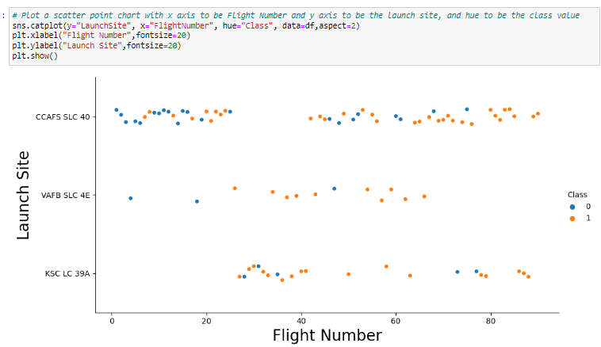
Flight Number vs. Launch Site
Earlier flights had a lower success rate (blue = fail)
•Later flights had a higher success rate (orange = success)
•Around half of launches were from CCAFS SLC 40 launch site
•VAFB SLC 4E and KSC LC 39A have higher success rates
•We can infer that new launches have a higher success rate

Slide 17
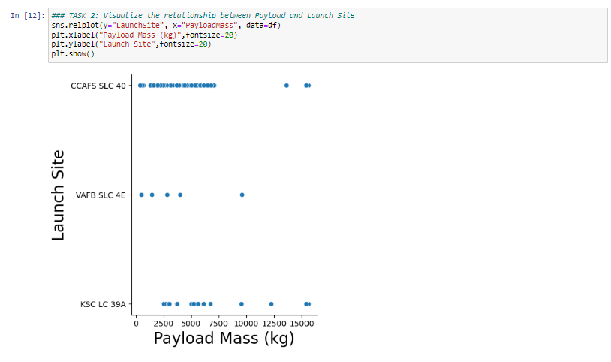
Payload vs. Launch Site
The higher the payload mass (kg), the higher the success rate
•Most launces with a payload greater than 7,000 kg were successful
•KSC LC 39A has a 100% success rate for launches less than 5,500 kg
•VAFB SKC 4E has not launched anything greater than ~10,000 kg

Slide 18
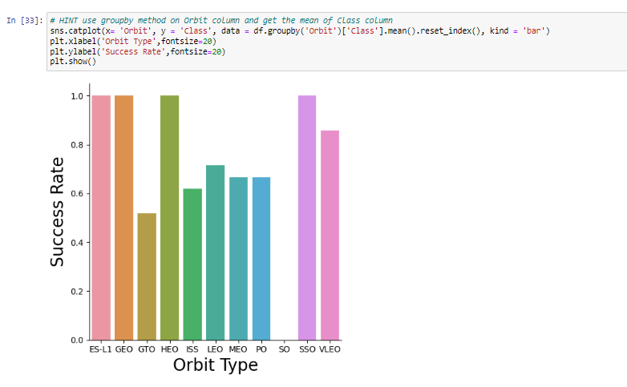
Success Rate vs. Orbit Type
100% Success Rate: ES-L1, GEO, HEO and SSO
•50%-80% Success Rate: GTO, ISS, LEO, MEO, PO
•0% Success Rate: SO

Slide 19
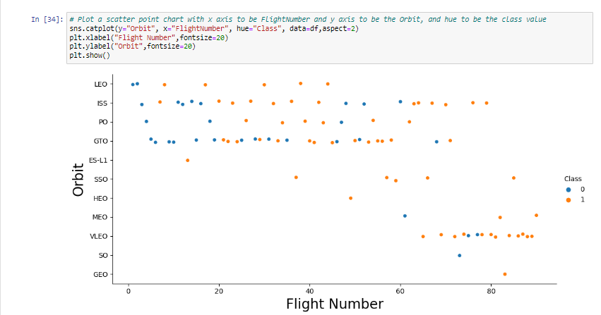
Flight Number vs. Orbit Type
The success rate typically increases with the number of flights for each orbit

Slide 20
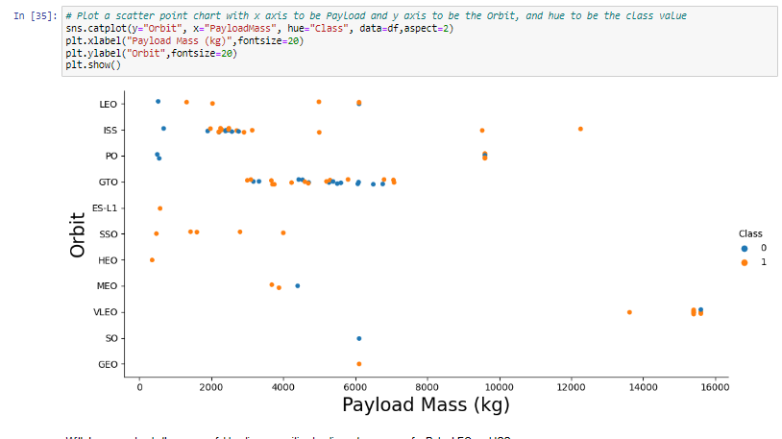
Payload vs. Orbit Type
Heavy payloads are better with LEO, ISS and PO orbits
•The GTO orbit has mixed success with heavier payloads

Slide 21
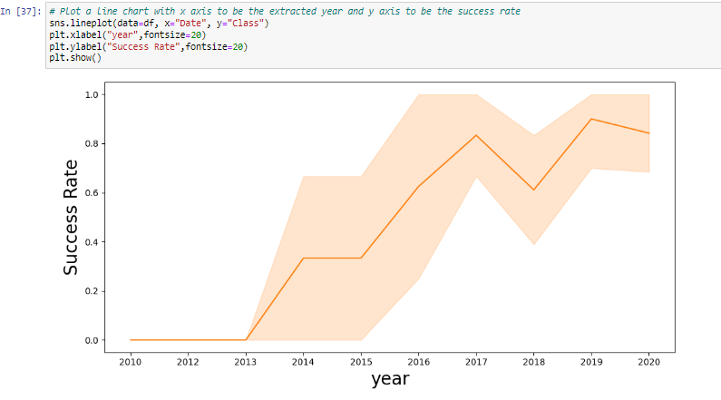
Launch Success Yearly Trend
The success rate since 2013 kept increasing

Slide 22
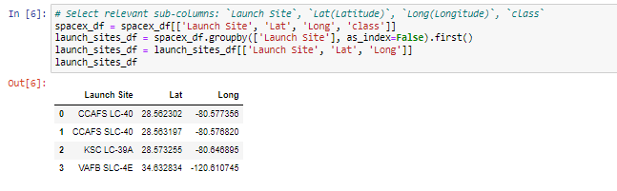
All Launch Site Names
List of Launch Site NNames

Slide 23
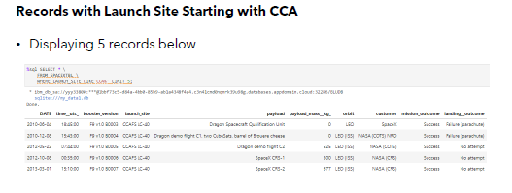
Launch Site Names Begin with 'CCA'
List of Launch Sites that begin with CCA

Slide 24
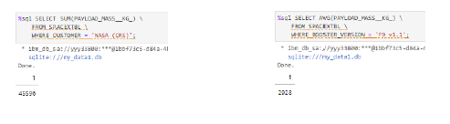
Total And Average Payload Mass
Total Payload and Average Mass

Slide 25
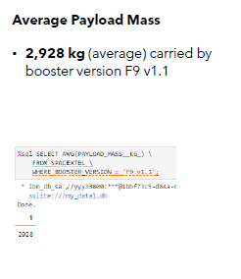
Average Payload Mass by F9 v1.1
Average Payload Mass by F9 v1.1

Slide 26
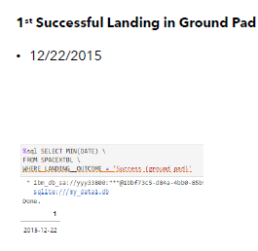
First Successful Ground Landing Date
First Successful Landing

Slide 27
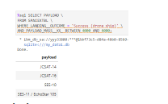
Successful Drone Ship Landing with Payload between 4000 and 6000
Successful Landings

Slide 28
Total Number of Successful and Failure Mission Outcomes
Failure Missions

Slide 29
Boosters Carried Maximum Payload
Boosters at max payload

Slide 30
2015 Launch Records (Failed landings)
Failed Landings 2015

Slide 31
Rank Landing Outcomes Between 2010-06-04 and 2017-03-20
Rank of Count of landing outcomes (such as Failure (drone ship) or Success (ground pad)) between the date 2010-06-04 and 2017-03-20, in descending order

Slide 32

Section 3

Slide 33
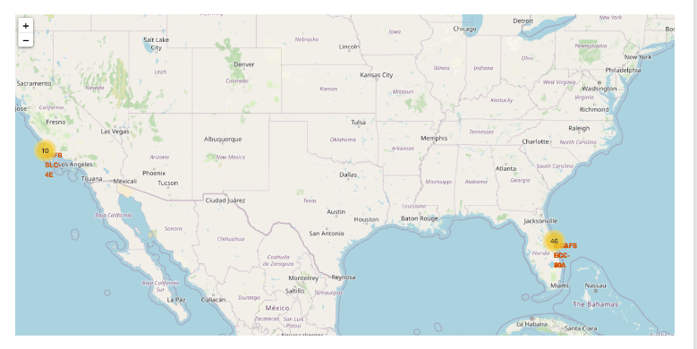
Launch sites Folium Mp
Folium Map of Launch Sites

Slide 34
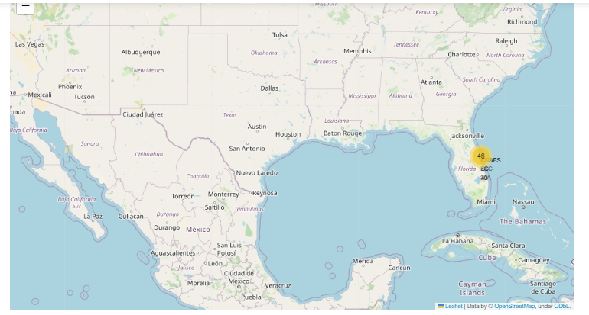
Launch Outcomes Folium Map
Explore the folium map and make a proper screenshot to show the color-labeled launch outcomes on the map

Slide 35
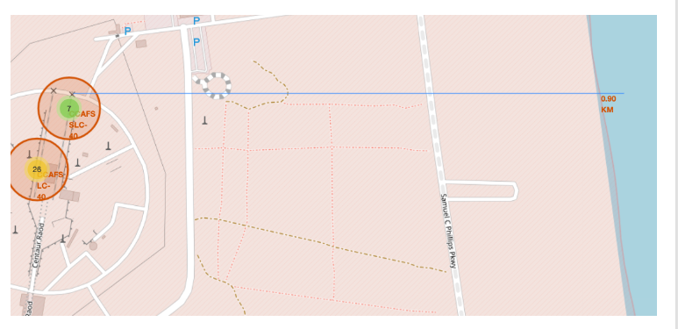
Distance to Proximities Folium Map
Ditance to Proximities

Slide 36

Section 4

Slide 37
Launch Success By Site
KSC LC-39A has the most successful launches amongst launch sites (41.2%)

Slide 38
Launch Site with highest launch ratio
KSC LC39A has the highest success rate amongst launch sites ( 76.9%10 successful launches and 3 failed launches

Slide 39
Payload Mass and Success
Payload vs. Launch Outcome scatter plot for all sites, with different payload selected in the range slider

Slide 40

Section 5

Slide 41
Classification Accuracy
. The Decision Tree model slightly
outperformed the rest when looking at best score

Slide 42
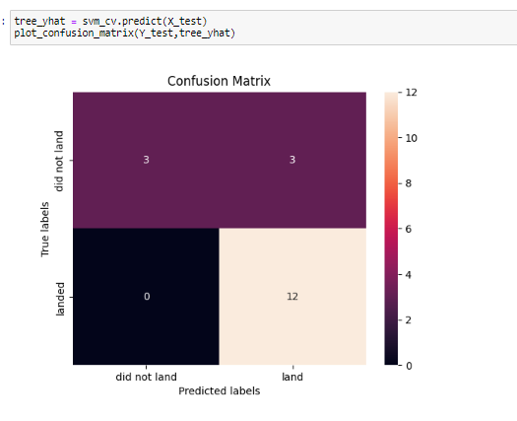
Confusion Matrix (Decision Tree)
Below is the confusion matrix of the best performing model (Decion Tree) with an explanation

Slide 43
Conclusions
Model Performance: The models exhibited similar performance levels when assessed against the test set, with the decision tree model displaying a slight edge.
Equator Advantage: The majority of launch sites are strategically located near the equator, capitalizing on Earth's natural rotational speed to reduce the need for additional fuel and boosters, thereby lowering costs.
Proximity to Coast: All launch sites are situated in close proximity to coastal regions.
Launch Success Trend: The likelihood of launch success shows a positive trend over time.
KSC LC 39A Excellence: KSC LC 39A boasts the highest success rate among all launch sites, achieving a flawless 100% success rate for launches weighing less than 5,500 kg.
Orbital Precision: Launches targeting ES L1, GEO, HEO, and SSO orbits consistently achieve a 100% success rate.
Payload Mass Impact: Across all launch sites, an increase in payload mass (measured in kilograms) correlates positively with a higher likelihood of mission success.

Slide 44


